Slide 1
Six Killer Strategies For Magazine Publishers
Rob O’Regan
Editorial Director
eMediaVitals.com

Slide 2
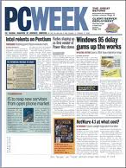
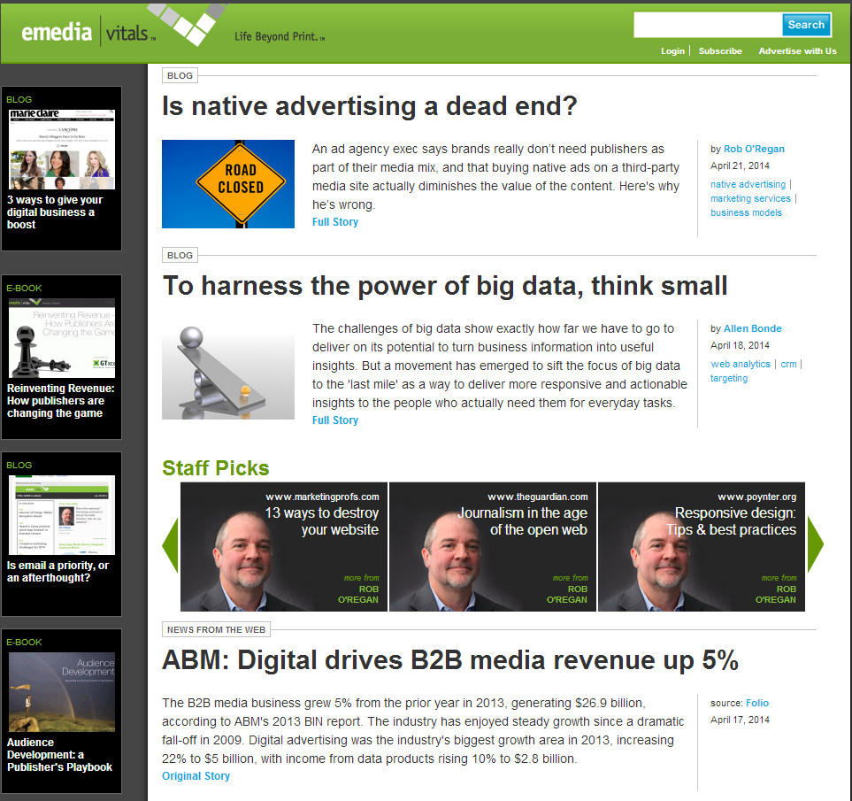
About me
Journalist
Content marketer
Digital retread

Slide 3
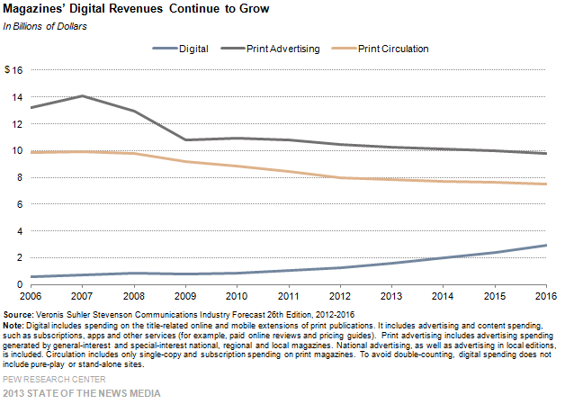
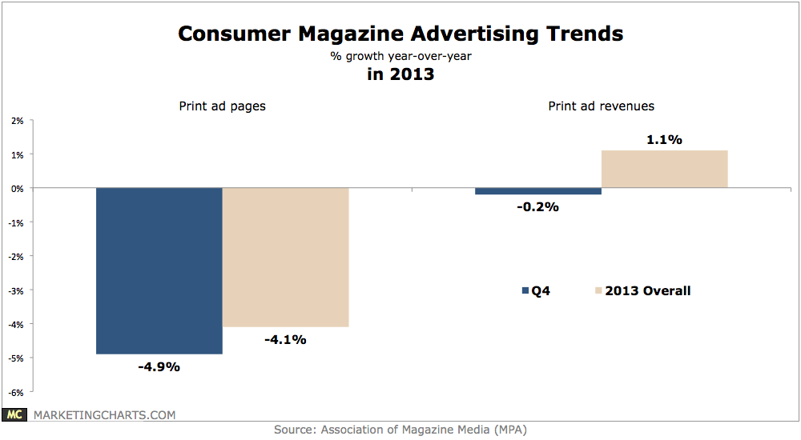
Publishing’s shifting landscape
68% of B2B marketers plan to decrease spending on traditional advertising/marketing channels in 2014
Notes:
Q1 2014*: US$4.01B
Q1 2013*: US$4.07B
%CHG: -1.60%
Q1 2014* Pages: 28,566
Q1 2013* Pages: 29,745
%CHG: -4.00%

Slide 4
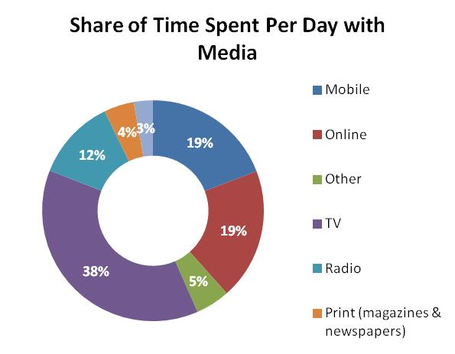
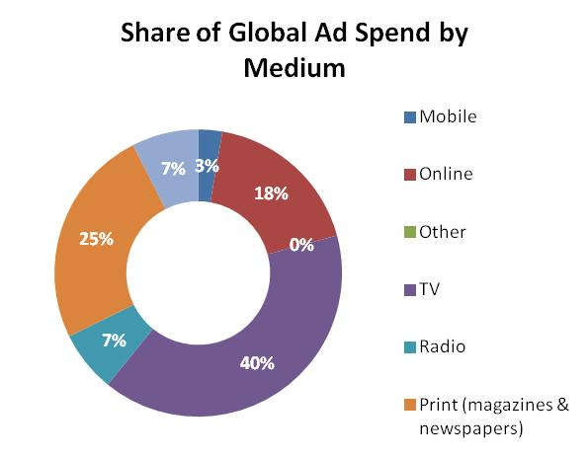
Ad spend still lags behind consumer behavior
Sources: eMarketer, ZenithOptimedia
Notes:
In 2013, consumers spent 38% of their media time online with PCs or mobile devices
Advertisers spent just 21% of their ad budgets on those channels

Slide 5
But there are signs of (digital) life
Global ad growth rates will rise from 3.9% in 2013 to 5.5% in 2014 to 6.1% in 2016. [Excel]
Eurozone ad spend to grow 0.7% in 2014 (its first year of growth since 2010), rising to 1.7% in 2016.
Global online ad spend grew 16.2% in 2013, a rate that will continue through 2016.
Global online display expected to grow at 21% annually through 2016 – overtaking paid search for the first time in 2015.
70% of B2B marketers said they plan to increase digital advertising expenditures in the year ahead
On average, B2B marketing budgets will rise 6% in 2014
Notes:
Global ad spend: http://www.zenithoptimedia.com/global-adspend-set-to-return-to-pre-financial-crisis-growth-rates/
B2B ad spend: Forrester and the Business Marketing Association. http://blogs.forrester.com/laura_ramos/14-01-21-b2b_marketers_expect_bigger_2014_budgets_how_will_you_spend_it_wisely

Slide 6
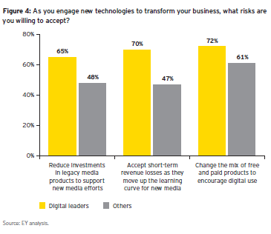
It’s time to pick up the pace
Notes:
http://www.emediavitals.com/content/digital-transformation-follow-money

Slide 7
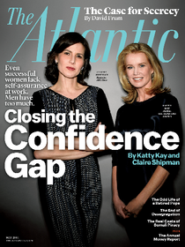
A transformational tipping point
2008
2012
2013
2011

Slide 8
SIX KILLER STRATEGIES FOR PUBLISHERS

Slide 9
1. Diversify in digital
Six Killer Strategies

Slide 10
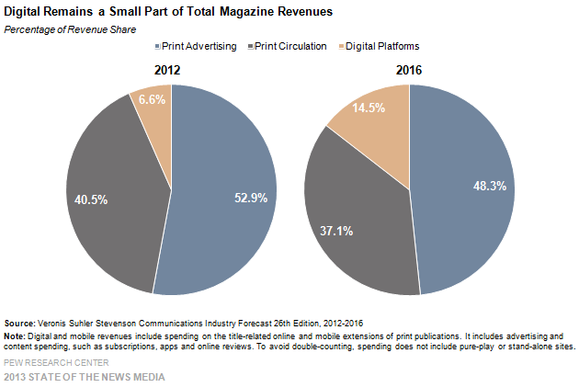
Digital Dimes ≠ Print Dollars

Slide 11
You need to stack a lot more dimes
Advertiser revenue:
Display advertising
Native advertising
Programmatic
Private ad exchange
Sponsorships
Affiliate marketing
Marketing services
Print/online/mobile/email
Reader revenue:
Subscriptions
Single-copy sales
E-commerce
Events
Data products
Apps

Slide 12
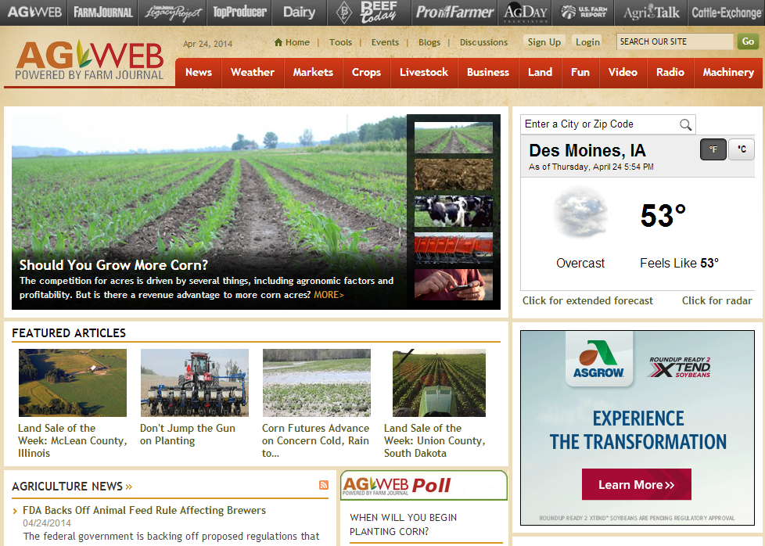
Farm Journal Media’s broad portfolio
Websites
Data products
E-newsletters
Mobile apps
Events
Episodic TV shows
A private ad network

Slide 13
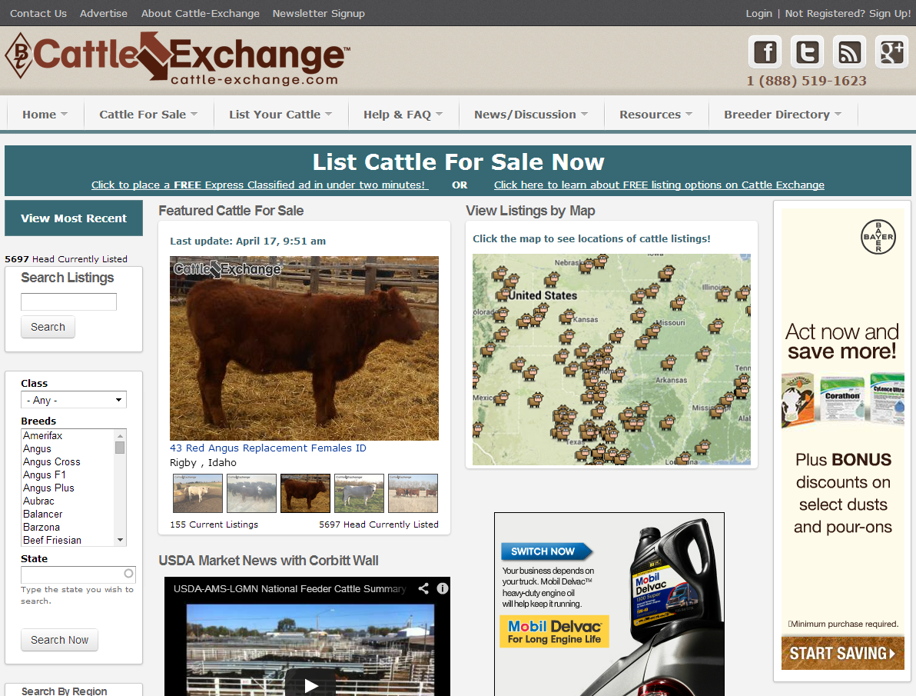
Continuous innovation
Diversification has put the business on track to grow its revenues by 80% over its current five-year planning period.

Slide 14
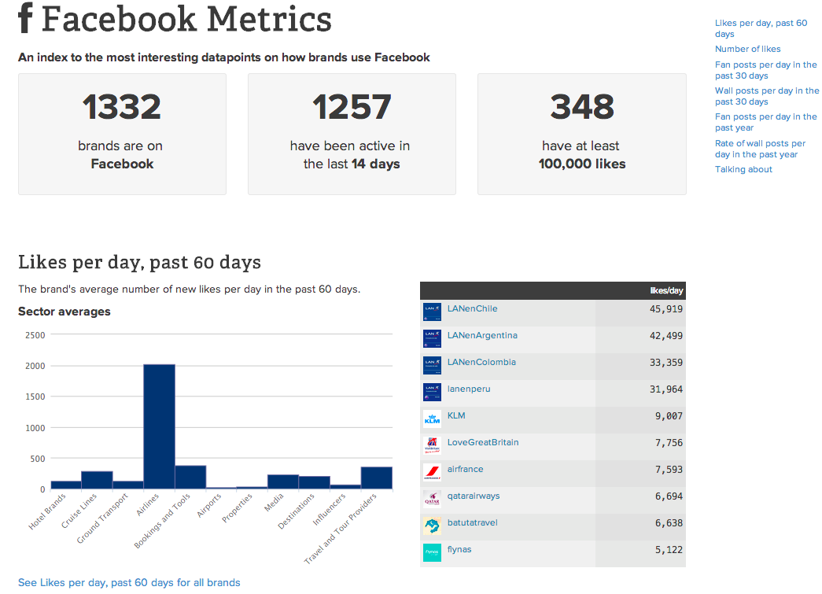
Data-driven diversification
Data for editorial
Data for sales
Data for audience development

Slide 15
2. EMBRACE THE ‘BRAND AS PUBLISHER’ TREND
Six Killer Strategies

Slide 16
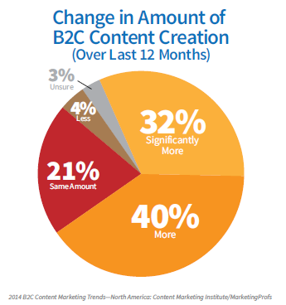
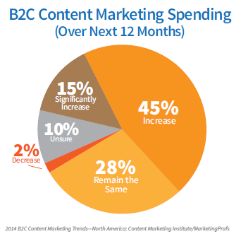
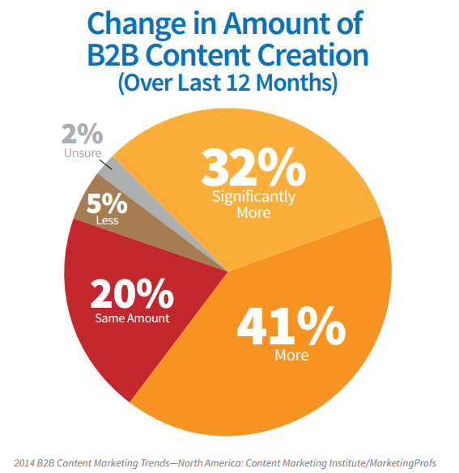
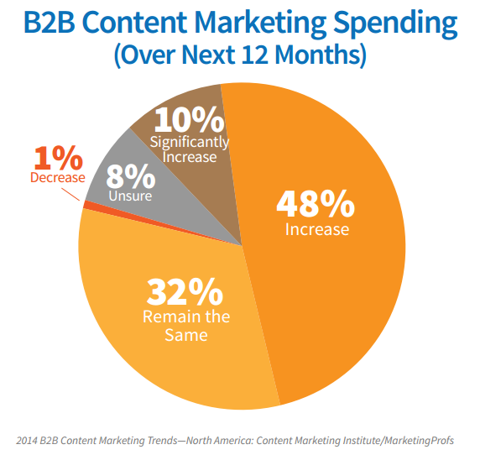
Brands are becoming publishers

Slide 17
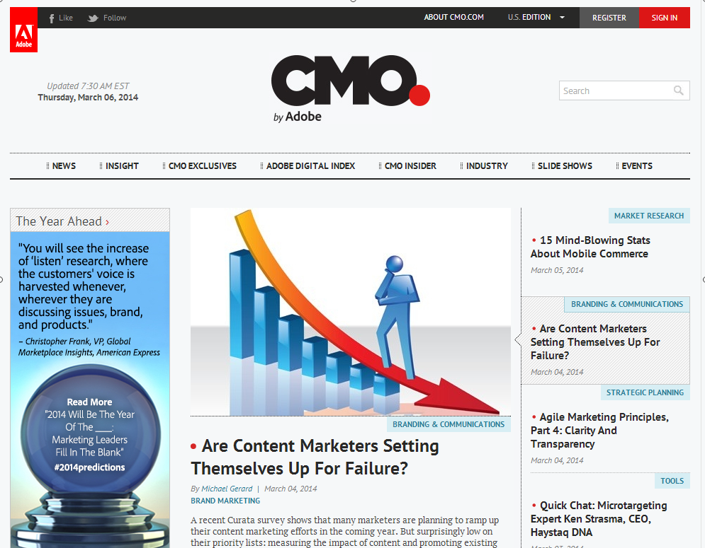
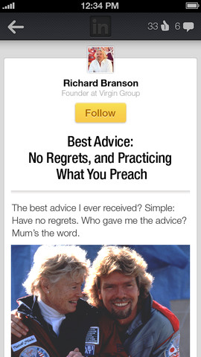
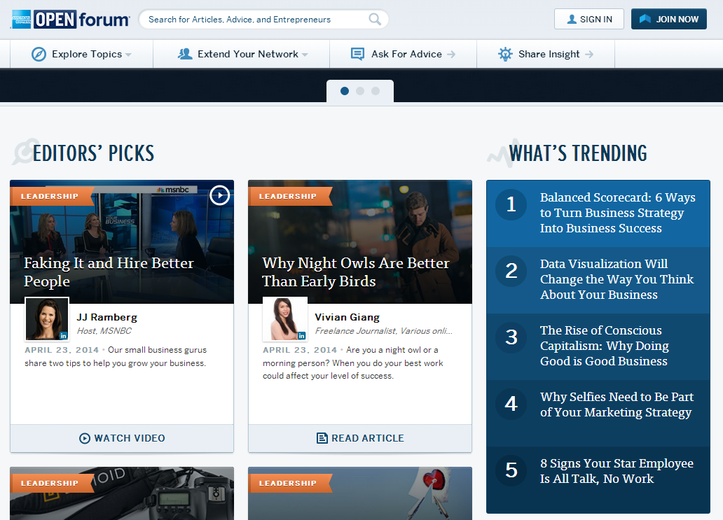
Some are aggressively building media brands

Slide 18
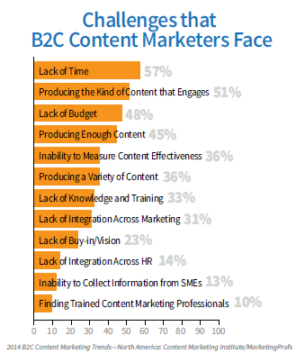
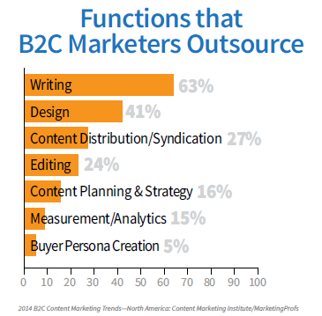
But most need help
Outsourcing + challenges = opportunity

Slide 19
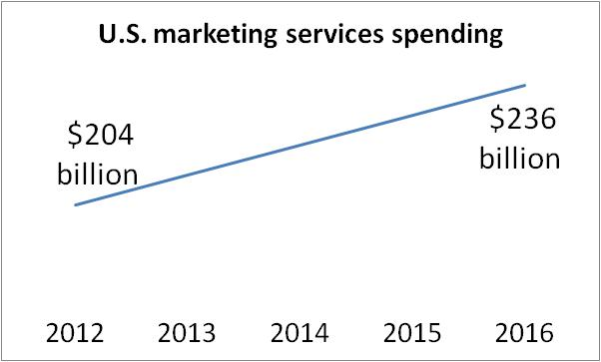
That’s why custom media and marketing services are booming
Source: Veronis Suhler Stevenson (VSS)

Slide 20
Marketing services: Beyond advertorials & white papers
Ghostwriting
Content syndication
Content management
Native advertising
Community management
Content auditing & optimization
Enewsletters
Web design & development
Creative design
Database marketing
Lead generation/nurturing
App development
Social media marketing

Slide 21
IDG Strategic Marketing Services
50+ people
Service lines include:
Mobile marketing
Social media marketing
Native advertising
Content optimization
Lead nurturing
Studio SIX: R&D lab for cultivating next-generation marketing services
Marketing services accounted for 25-30% of total U.S. revenues in 2013

Slide 22
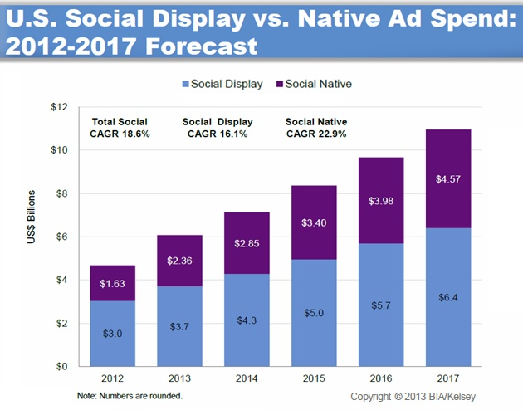
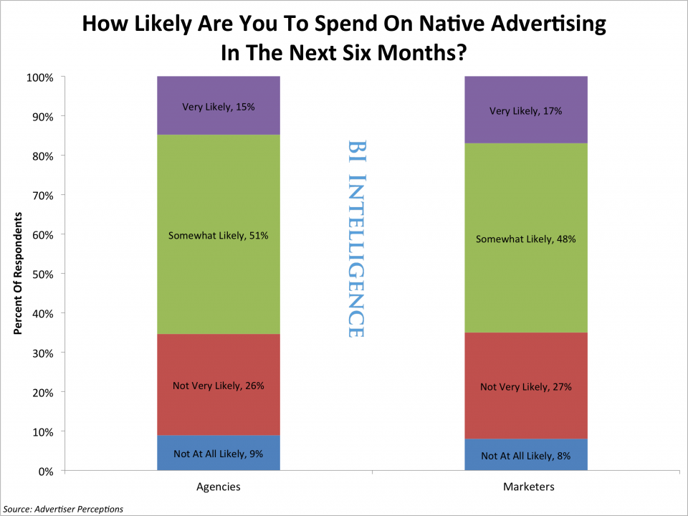
The native advertising opportunity
Notes:
http://www.businessinsider.com/the-rise-of-social-native-advertising-2013-10
http://www.marketingprofs.com/charts/2013/10593/us-social-ad-revenues-to-reach-11b-in-2017

Slide 23
Native pioneer: Forbes
31 partners
1,700 posts
11M pageviews
20% of total ad revenue in 2013
Notes:
http://www.emediavitals.com/content/native-programmatic-drive-forbes-growth-new-mobile-products-wings

Slide 24
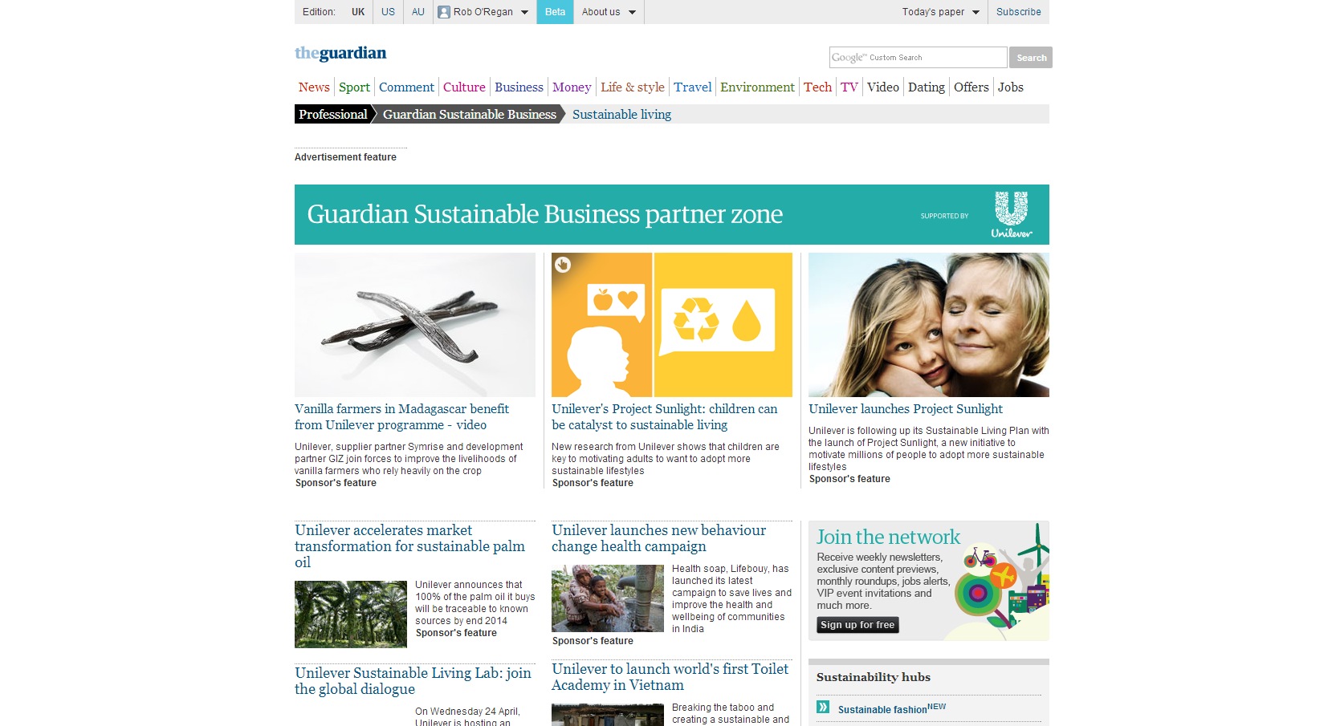
The Guardian’s 7-figure native ad deal
Notes:
http://www.emediavitals.com/content/guardian-kicks-new-labs-unit-seven-figure-native-ad-deal

Slide 25
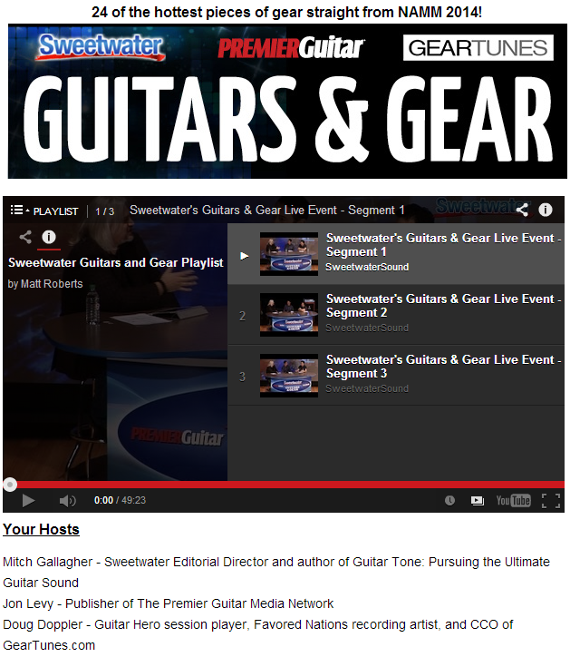
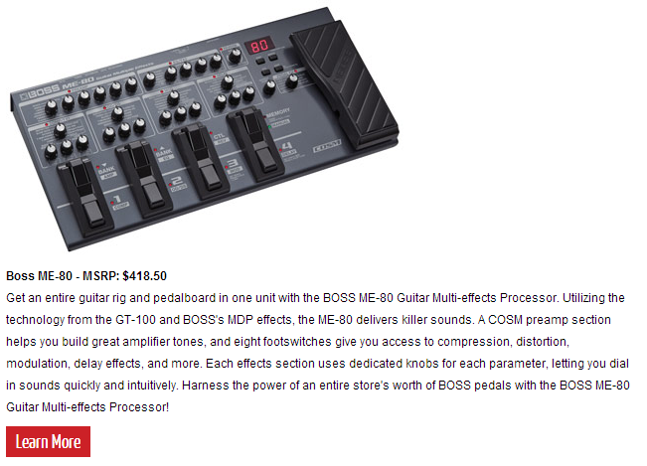
Not just for large publishers
Premier Guitar program with Sweetwater
‘Virtual trade show’: 24 coolest products released at NAMM
On-air hosts from Sweetwater, PG and Geartunes.com
204,000 video views
Sweetwater: sales for guitars and related gear in March were up more than 50% Y-O-Y
http://www.sweetwater.com/store/detail/ME80
Notes:
http://www.premierguitar.com/guitarsandgear

Slide 26
3. PUBLISH WITH A (RE)PURPOSE
Six Killer Strategies

Slide 27
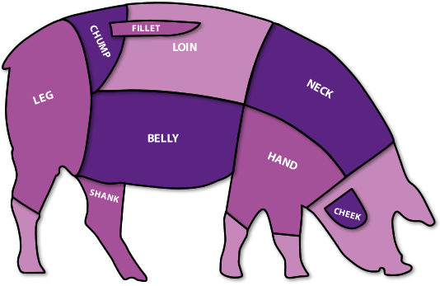
Maximize your editorial
PODCASTS
E-BOOKS
SOCIAL MEDIA
INFOGRAPHICS
BLOGS
FEATURES
ARTICLES
VIDEO
NEWS-LETTERS

Slide 28
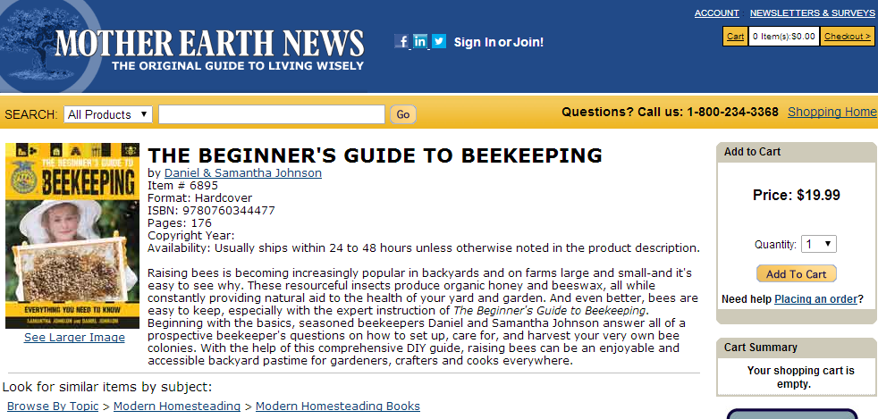
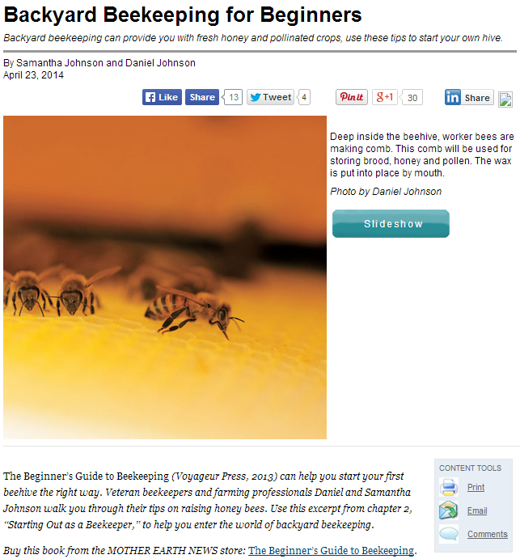
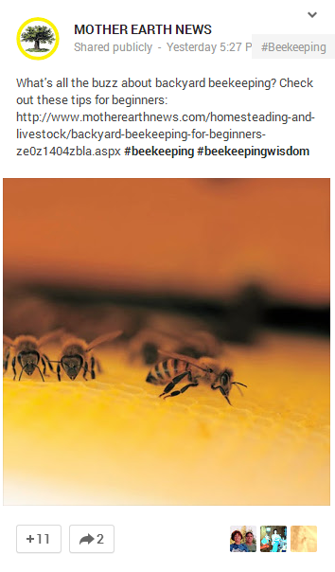
Repackaging original content

Slide 29
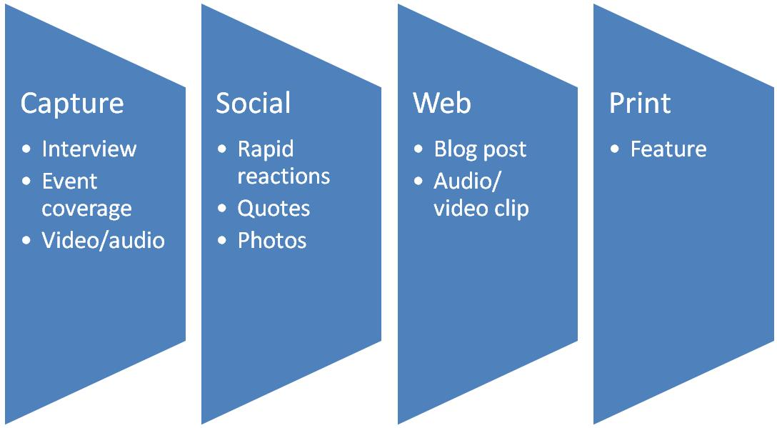
Digital first: Reversing the workflow

Slide 30
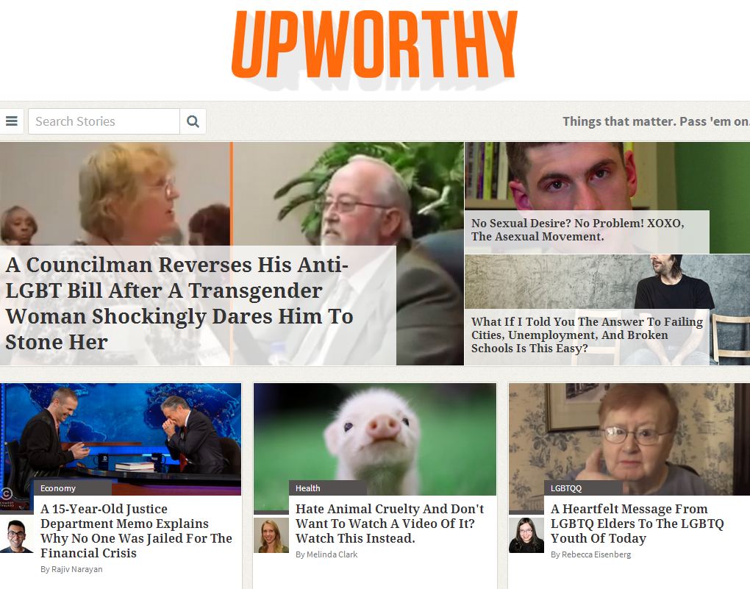
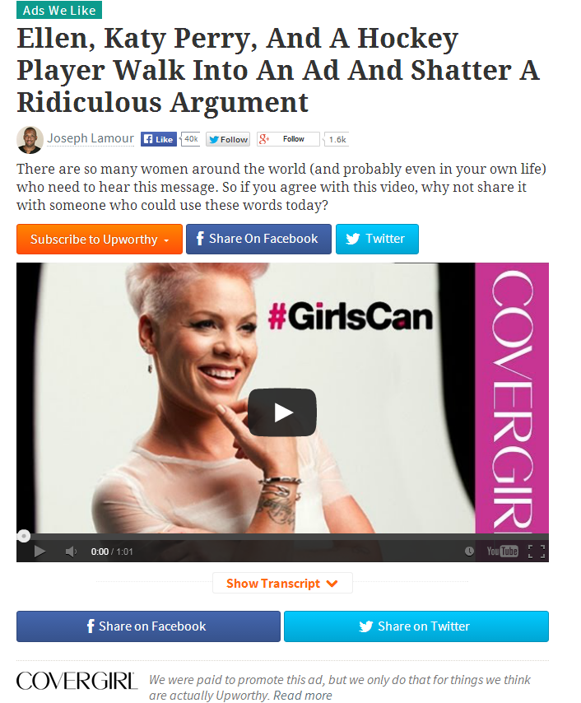
Add aggregation & curation to the mix

Slide 31
4. TURN PRINT INTO SOMETHING SPECIAL
Six Killer Strategies

Slide 32
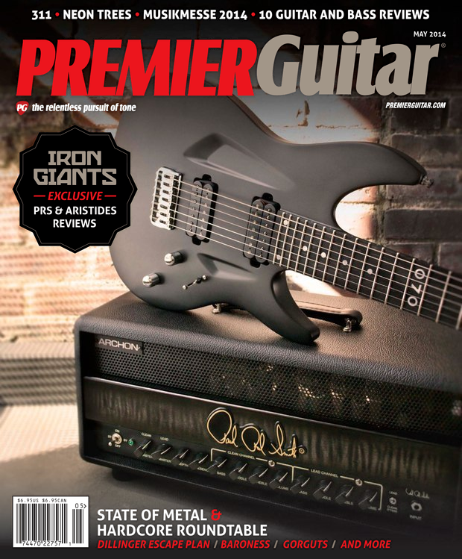
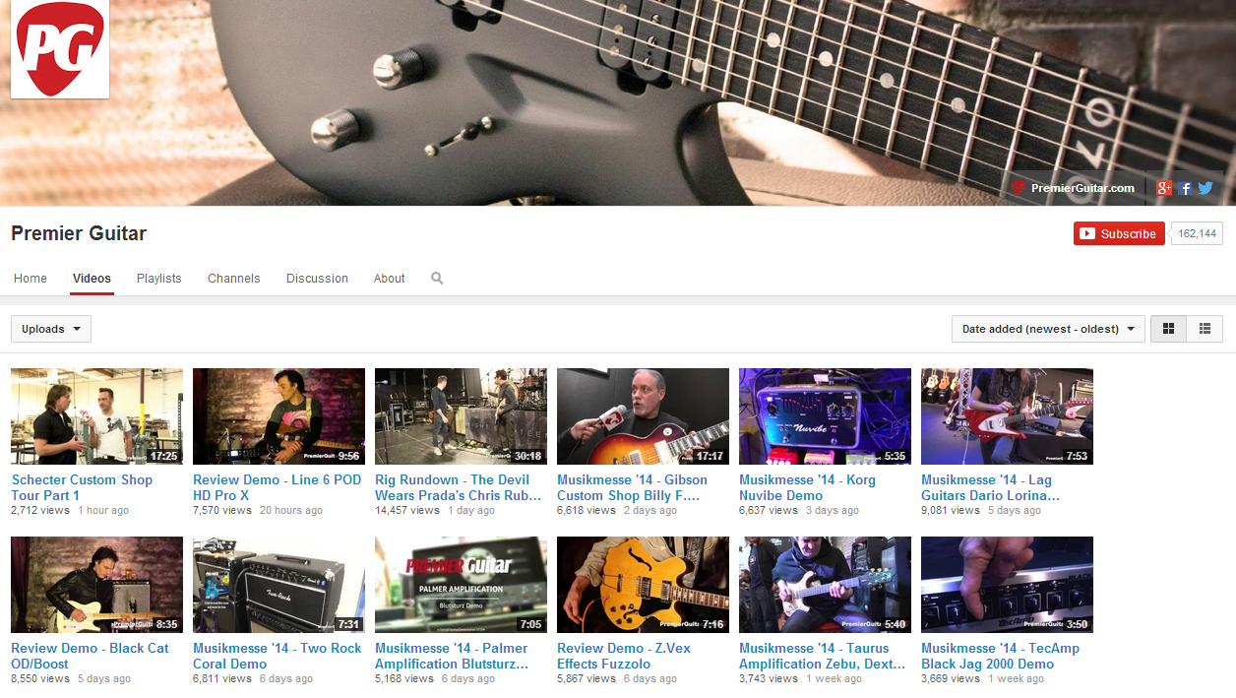
Future of print?
“Print is not dead – though it will become increasingly coffeetableish and collectible.”
Peter Sprague,
Premier Guitar

Slide 33
Special editions drive incremental $$
Notes:
http://www.emediavitals.com/content/3-lessons-sis-swimsuit-issue-publishers-marketers
http://www.foliomag.com/2014/playboy-re-releases-its-first-issue-60-years-later?hq_e=el&hq_m=2868613&hq_l=8&hq_v=c700bef533#.U1UJTqLTnh0
http://www.farmcollector.com/shopping/detail.aspx?itemnumber=4639

Slide 34
Cautionary tale: Be proactive
131 years in print
Will become a newsstand-only special interest publication

Slide 35
5. Be a mobile leader, not a laggard
Six Killer Strategies

Slide 36
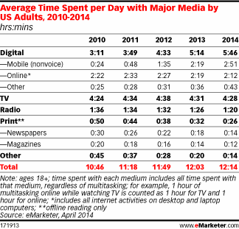
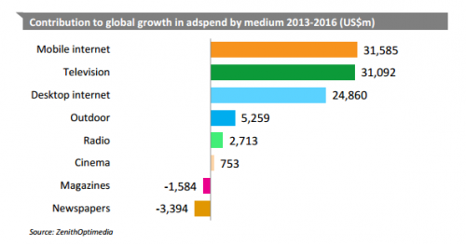
A game-changer
Notes:
http://www.emarketer.com/Article.aspx?R=1010782

Slide 37
Responsive design: COLE Publishing

Slide 38
Responsive email: Advantage Business Media

Slide 39
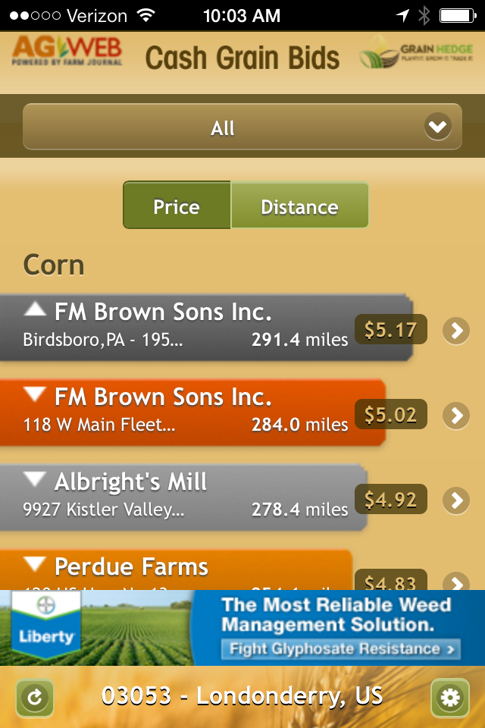
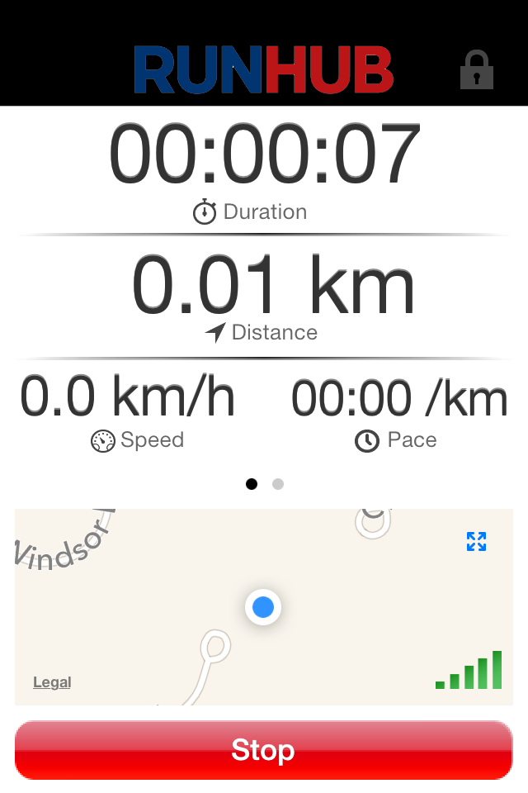
Are apps necessary?
Mobile web for information
Mobile apps for utility

Slide 40
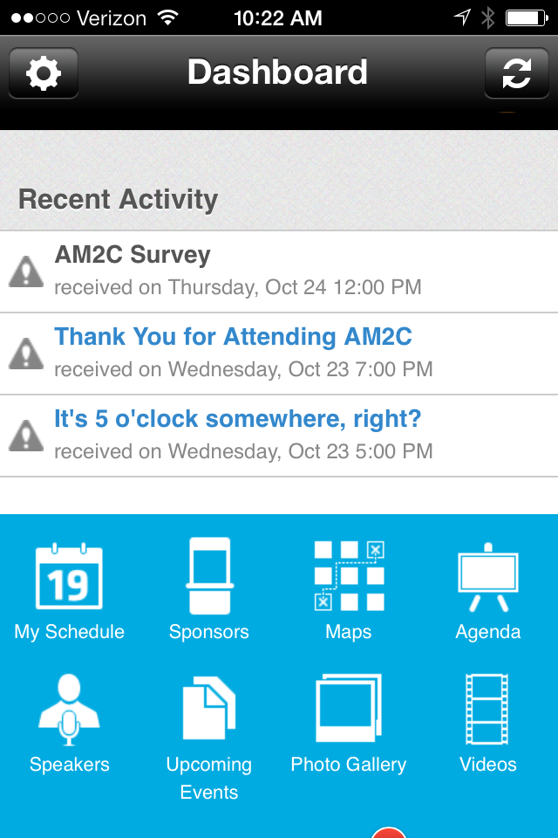
Apps for events
Agenda & schedules
Speaker profiles
Sponsor profiles
Social feeds
Networking
Maps
Utility, engagement, monetization

Slide 41
6. Amaze & Delight Your Audience
Six Killer Strategies

Slide 42
Old school

Slide 43
New school

Slide 44
A red velvet approach
Serve the individual
Honor their unique preferences
Deliver timely, relevant content that improves their lives
Surprise them with access
Delight them with your humanity
Source: “Audience” by Jeffrey K. Rohrs
Notes:
http://www.emediavitals.com/content/red-velvet-approach-audience-development

Slide 45
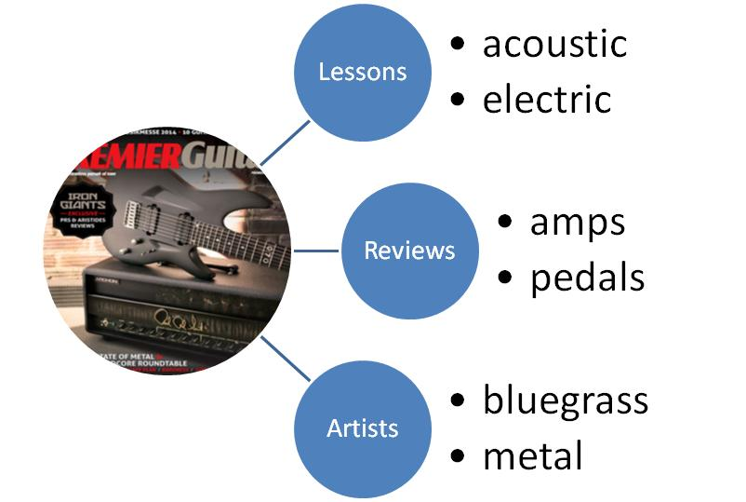
Get even nichier
Find the seams
‘Subcompact’ publishing
Deeper levels of engagement
Stronger sense of community

Slide 46
6 Killer Strategies
Diversify in digital
Embrace the ‘brand as publisher’ trend
Publish with a (re)purpose
Turn print into something special
Be a mobile leader, not a laggard
Amaze & delight your audience

Slide 47
Questions?

