Slide 1
PPA UK
2014

Slide 2
Marketing Strategy
2013/2014
Change the proposition:
demonstrate rather than narrate
find a central truth: multi-platform activities underneath the influential brand
Redirect emphasis of traditional messaging
broadcast as well as narrowcast

Slide 3
Marketing Strategy
2013/2014
Change the proposition:
demonstrate rather than narrate
find a central truth: multi-platform activities underneath the influential brand
Redirect emphasis of traditional messaging
broadcast as well as narrowcast
Change the operation:
build in collaboration (member/agency/ppa)
re-invest in Advertising Awards => buzz, goodwill, case studies, sharable proofs
more groups! Yes, but the right ones
listen to the customers
invest in a digital comms framework => represent the core message; look good; shareable (encourage sharing)

Slide 4
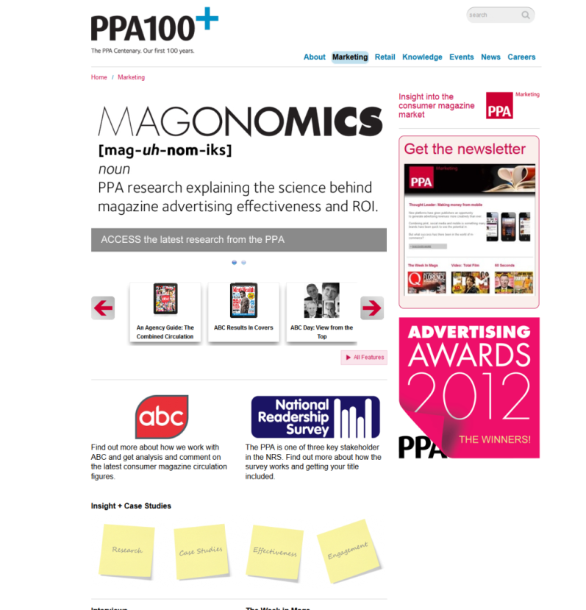
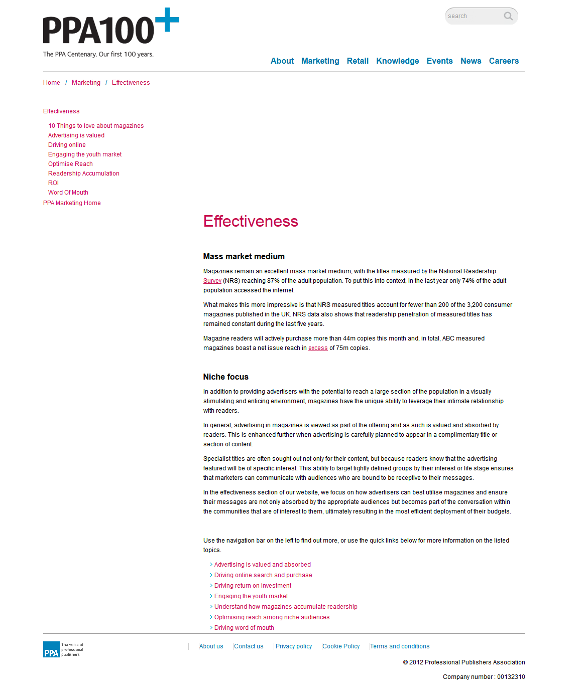
A digital comms
framework

Slide 5
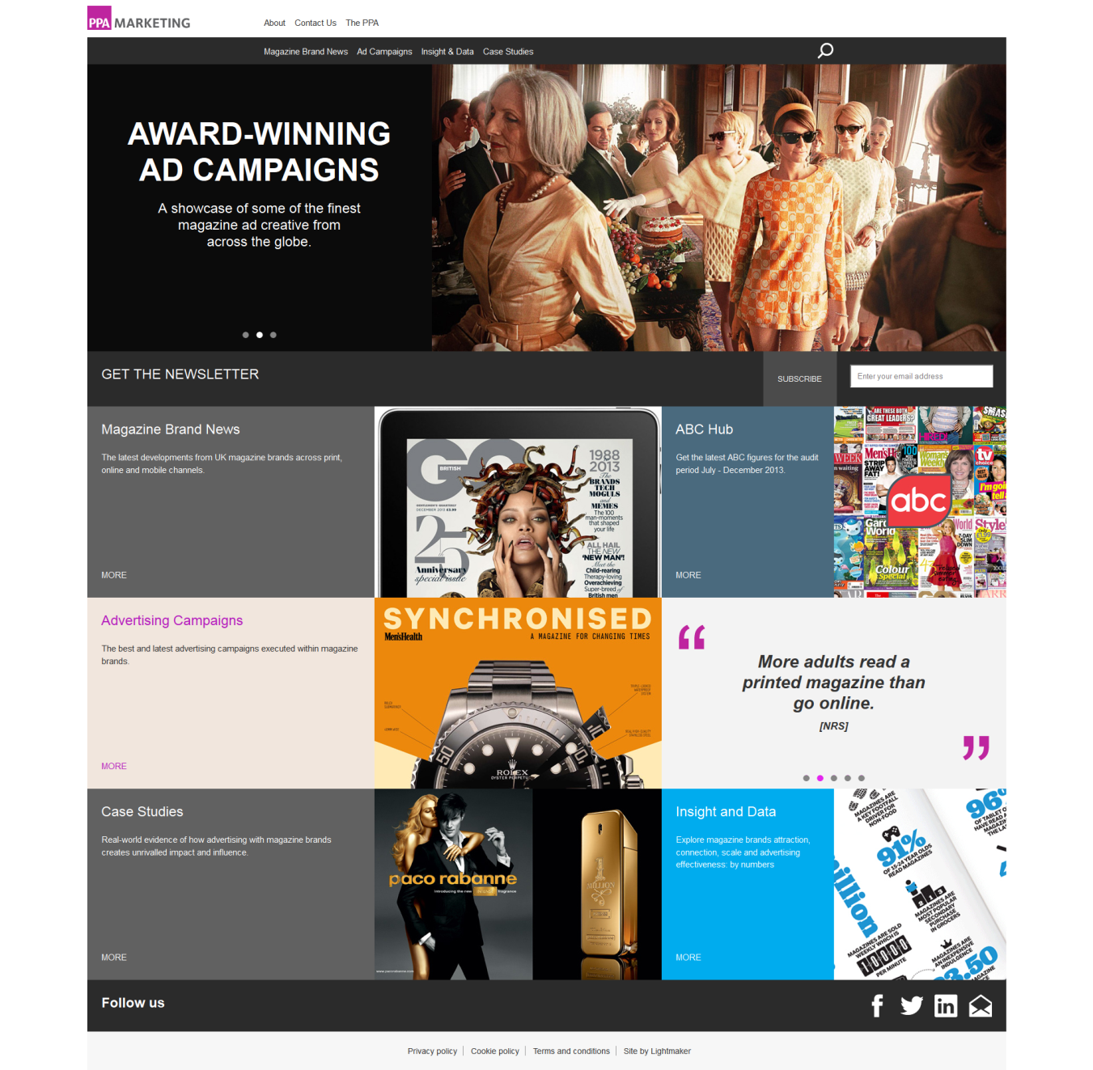
A digital comms
framework

Slide 6
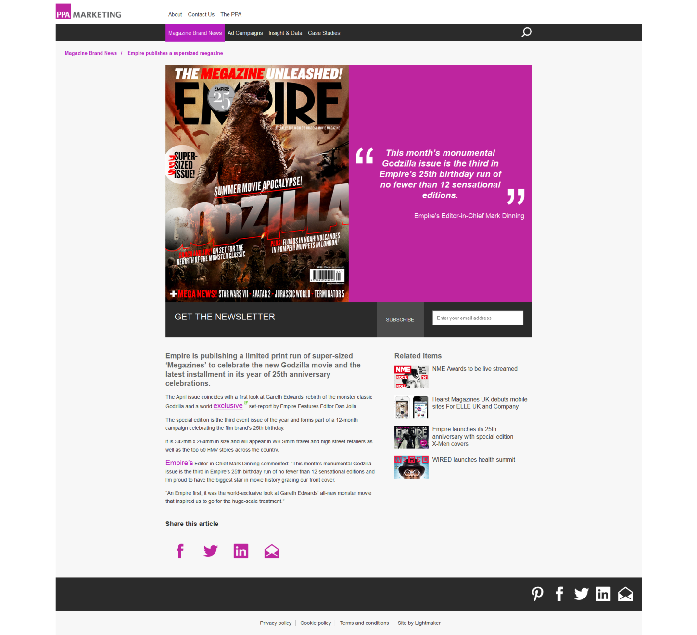
A digital comms
framework

Slide 7
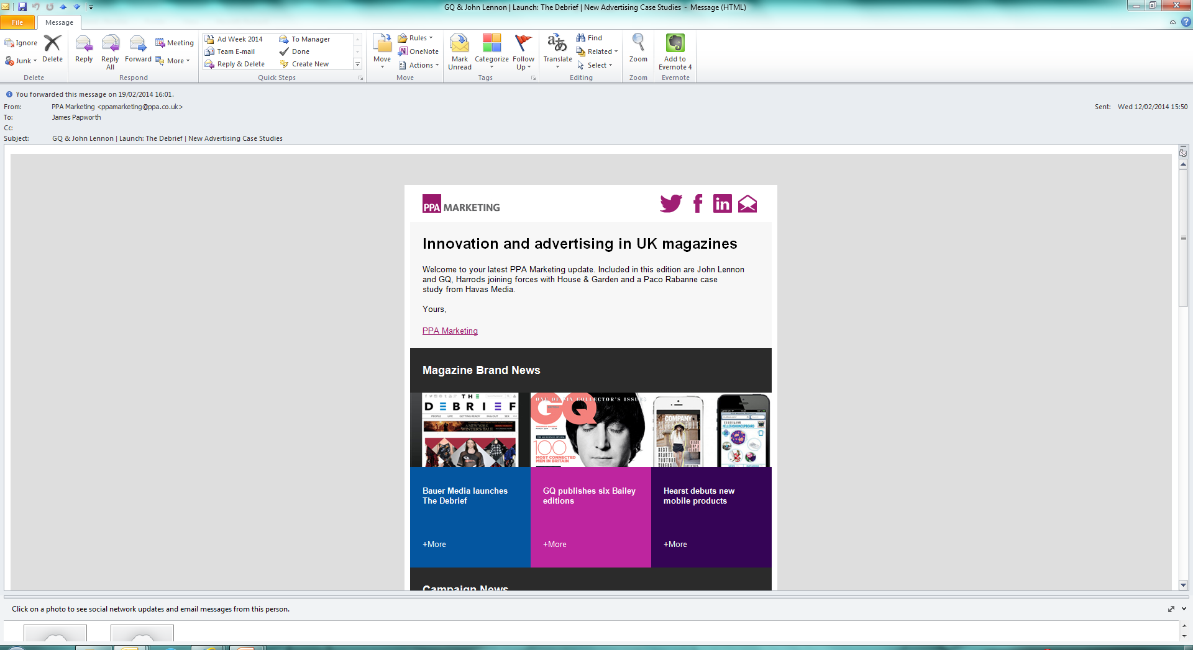
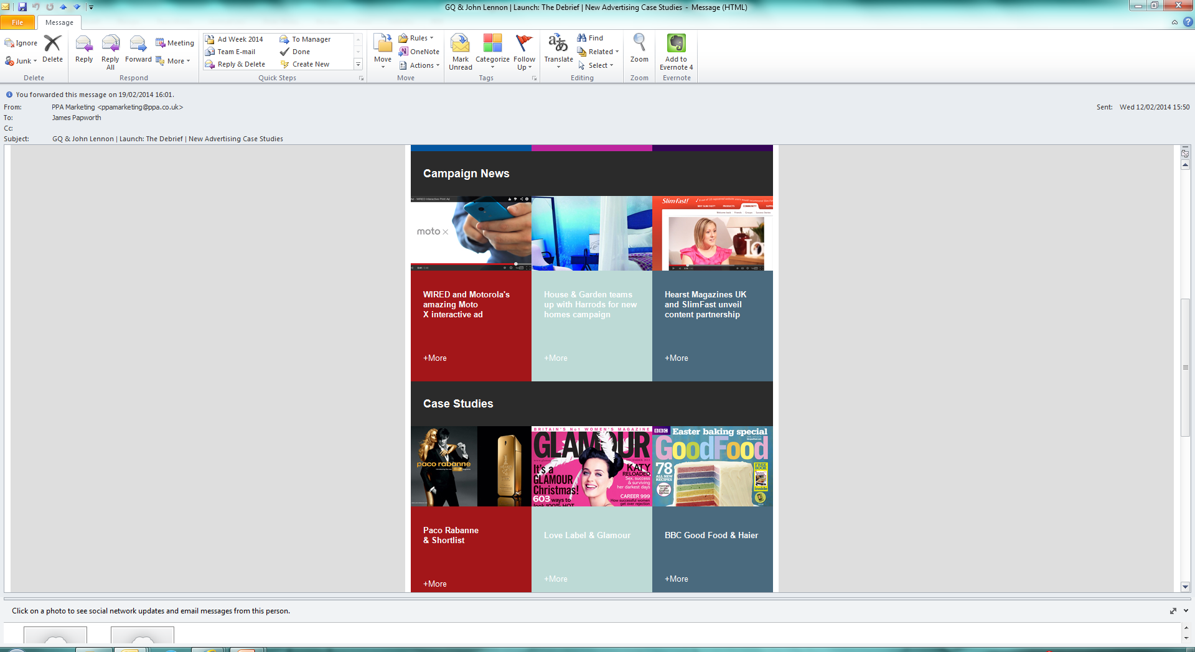
Evolved content &
design

Slide 8
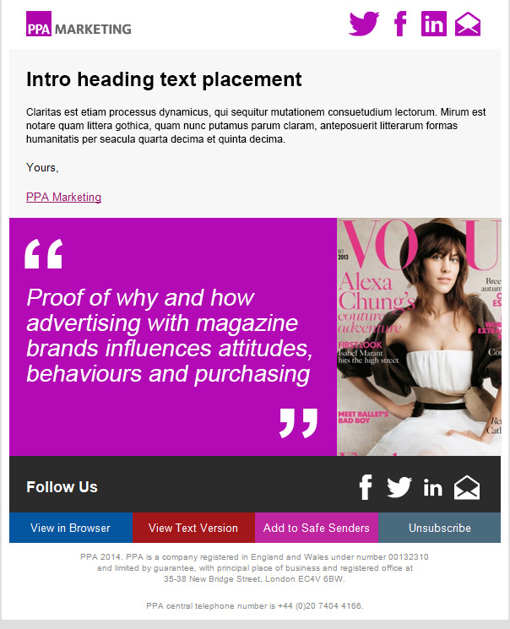
Evolved content &
Design & distribution
http://www.ppa.co.uk/marketing
http://www.pinterest.com/ppamarketing/
http://www.pinterest.com/ppamarketing/covers

Slide 9
EXAMPLE:
CLIENT-SIDE PRESENTATION

Slide 10









Magazine Brands
2014

Slide 11
… WHO’D HAVE THOUGHT?
brand popularity in print
multi-platform reach
a GROWING audience
‘social climbers’

Slide 12

Brand Popularity
MORE THAN
79%
adults
x3
NRS Year to March 2013 / PPA

Slide 13
Brand
Popularity
1 million more than
NRS Year to March 2013 / PPA

Slide 14

Brand
Popularity
MAGAZINE CHOICE PER CAPITA
2nd
… among G8
China & Brazil
2,534 consumer options
choice +10%
since the internet
FIPP / BRAD / PPA

Slide 15
Multi-Platform:
Brand Reach from NRS PADD
“When it comes to talking about media reach magazines are rarely used the same sentence as Goggle, BBC or ITV. But there’s no reason why they cant be”. MD Advertising, IPC
men’s lifestyle & music:
+35%
women’s lifestyle & fashion: +14%
abc1 adults: 1m+
NRS PADD 2013 Print & Online Reach

Slide 16
BRAND REACH HAS INCREASED IN LAST 5 YEARS
INCREASED NET REACH
2008
2013
higher reach of: adults, abc1, 25-54 … +1million
NRS Jan to Dec 2008 / NRS PADD Jan to Dec 2013

Slide 17


CONNECTED AUDIENCES & SOCIAL BRAND REACH
3 of the fastest growing media pages of facebook globally, are Elle, Zoo & Glamour
Kerrang and Zoo have more UK facebook fans than ITV
Economist and Vogue have more UK Twitter followers than Radio 1
Socialbakers.com @ Feb 2014

Slide 18
CONTENT
1.
THE ROLE OF MAGAZINES IN
AUDIENCES LIVES
ADVERTISING INFLUENCE
AND ROI
BRAND INNOVATION

Slide 19
Brand Association
The Role of
Magazines
Adding Value
Me-time

Slide 20
My Brand
Brand Association
Magazines scored highest on,
Adding Value
Me-time
Identification
Stimulation
Innovation
Motivation
52% agree “My choice of magazine says something about the kind of person I am”
TNS 2012 & many global studies

Slide 21
Adding Value
Brand Association
Magazines scored highest on,
Adding Value
fits my needs
suits my interest
I learn new things
gives me ideas
Me-time
Magazines are perceived by audiences to be “the most relevant to me”
Carat: Consumer Connection System UK, many world studies

Slide 22
Adding Value
... through trust, expertise, inspiration
4,000 young women said ‘their’ magazine brands are:
the most trustworthy source of information
x3 more trusted than TV
2nd most trusted source of recommendations … just behind their friends
vital for staying up to speed: 20% follow their brands on social
more inspiring than any other media they use
21st Century Women / Conde Nast 2012

Slide 23
“
Adding Value
... through authenticity
In this environment of Twitter and fast information, magazines are more necessary than ever. They offer considered content & curated ideas which have been meticulously researched and put together by editors.
Managing Director,
Condé Nast
”

Slide 24
Me-Time
Brand Association
Audience ‘mood’ studies consistently link magazines with,
Adding Value
Me-time
relaxation
a reward
an escape
“it’s a break”
68% of printed magazine reading is done alone, compared to 24% of TV viewing
Global Studies, IPA TouchPoints 2012

Slide 25
“
Me-Time
There’s something about opening a magazine, freshly printed – the smell of it. There’s just something about holding it in your hands and sitting on the couch … the opportunity it gives you to relax.
Female ipad owner.
Meredith/Mediavest USA,
Guidelines for maximising the
Value of Tablets versus Print Magazines [2011]
”

Slide 26
INSPIRING FANS WITH THE MOST AUTHENTIC
CONTENT IN THE WORLD

Slide 27
CONTENT
THE ROLE OF MAGAZINES IN AUDIENCES LIVES
BRAND INNOVATION
2.
INFLUENCE & ROI

Slide 28
Oasis of Focus
the least distracted content consumption
#1 Magazines
#2 Newspapers
#3 Radio
#4 TV
#5 Internet
BIG Research USA and others

Slide 29
Advertising is welcome
“
Audiences and Marketers prefer to see adverts in: a favourite magazine
45% of consumers
55% of marketers
Magazines rank twice as high as 2nd placed tv
”
Adobe 2012

Slide 30
Advertising feels personal
“
Audiences rank advertising in 10 media. Magazine adverts headed 5 criteria:
I feel involved
It made me excited
I found it original
I found It useful information
It offers me something new
”
TNS Media Experience Study 2012 and others

Slide 31
The positive mood enhances advert reception
350
MAGAZINES
300
INTERNET
250
TELEVISION
200
150
Trustworthy
Inspirational
Life
Enhancing
Social
Interaction
Ad
Receptivity
Experian Simmons Multi-media Engagement Study

Slide 32
Evidenced by high recall
NOTED SCORES
ADVERTISING
54%
EDITORIAL
54%
NET ACTION SCORES
EDITORIAL
66%
ADVERTISING
63%
PPA Magnify 2011

Slide 33
Mutual friends: Advertising that creates a bond say Mindshare
BONDING
ADVANTAGE
average 7% spend in magazines
PERFORMANCE
25%
<£2m
Campaign Value
RELEVANCE
72%
PRESENCE
£2m – £10m
Campaign Value
Brands which invest 20% above average* in magazines enjoy significantly higher bonding scores than brands that underinvest
Group M: BrandZ: 136 Brands using magazines
*Based on average share of spend of 7% in 2011: Source WARC/ AA

Slide 34
Proof of value: the highest ROI of all say Mindshare
ANALYSIS OF 77 FMGC CAMPAIGNS WITH A SPEND UP TO £6M
150
MAGAZINES
167
… relative ROI per channel
“Advertising investment in printed magazines gives brands the highest ROI of all”.
(Mindshare in Magonomics)
137
Mindshare Meta Analysis of 77 fmcg Campaigns

Slide 35
Amplified by Influentials
9% who influence 91%
+90% read magazines
“By virtue of its widespread reach, television sparks the most brand conversations by volume. But print is better than any other media at reaching influencers. And influencers are the most active recommenders.”
The Word of Mouth Marketing Association
Keller & Berry / TGI 2012

Slide 36
BRAND, FOCUS, MOOD AND RECEPTIVITY LEAD TO INFLUENITIAL CONNECTIONS AND SURPRISING ROI

Slide 37
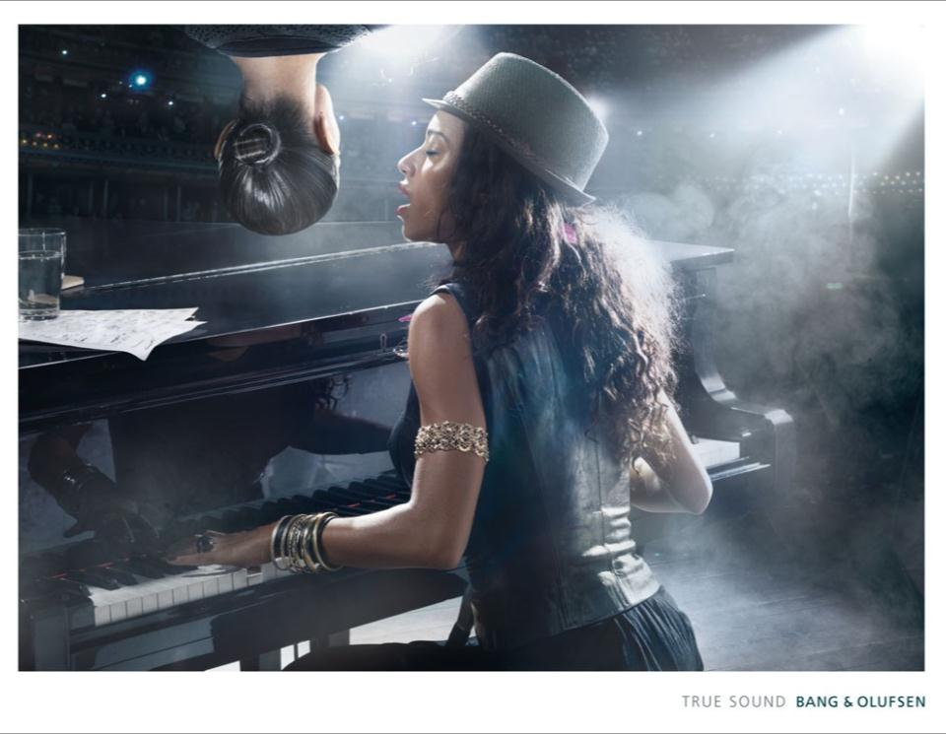
... in 2012
17 of the UK’s top 20
COOLEST BRANDS
advertised in magazines
Cool Brands Expert Council / Nielsen AdDynamix: 2012

Slide 38
CONTENT
THE ROLE OF MAGAZINES IN AUDIENCES LIVES
INFLUENCE & ROI
3.
BRAND INNOVATION

Slide 39

DIGITAL NATION
UK is 10th most digital nation in the world - out of 197 nations
The UK is more ‘digital’ than the USA, Germany, China, and Japan
‘NATIONAL DIGITALNESS’
10th
ahead of,
USA
China
Germany
Japan
ZenithOptimedia February 2013 / Enders Analysis

Slide 40
CONNECTED NATION
Over 50% of the UK use two devices to regularly connect to the internet
30% use three. Four times the EU average
50%+
use two devices to access internet
30%
use three
IAB Europe Mediascope 2012 (x28 countries)

Slide 41
TABLET POPULATION
30 million tablets in the UK by 2015
2013 2014 2015
You Gov Jan 2014 / ABC Feb 2014

Slide 42
DIGITAL EDITION INNOVATION
52% year on year increase in digital edition magazine brands available
61% increase in copy sales @ 550,000*
546,822
335,443
96,589
2011 2012 2013
Mediatel / ABC. Does not include Digital Publications*

Slide 43
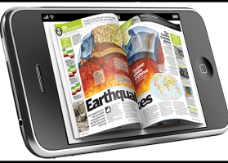


New for 2014
DIGITAL EDITION AGGREGATOR APPS
UNLIMITED CONTENT £9.99
2013 2014 2015
Mediatel / ABC. Does not include Digital Publications*

Slide 44
A FEW EXAMPLES … IN 2014

Slide 45
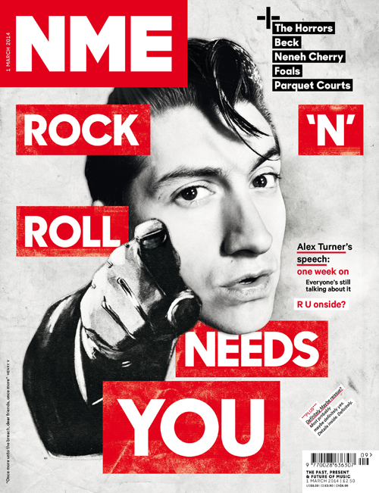
ONLINE INNOVATION
The NME Awards 2014 with Austin, Texas will be streamed live via NME.com for the very first time in the event’s history.
The awards take place today (Wednesday February 26) at O2 Academy, Brixton and fans around the world will be able to watch all of the action online from 8pm.
NME is working with LoveLive and Streaming Tank to broadcast the HD footage.
Richard Cohen, Lovelive CEO, said: “The NME Awards is one of the biggest musical events of the year and we are thrilled to be the live streaming partner.
“By offering a multi-platform experience, we’re giving fans all the unmissable moments as they happen from the night wherever they are and on whatever device they choose.”
Highlights from the events will also be available on nme.com.
Feb 2014
www.ppa.co.uk/marketing

Slide 46
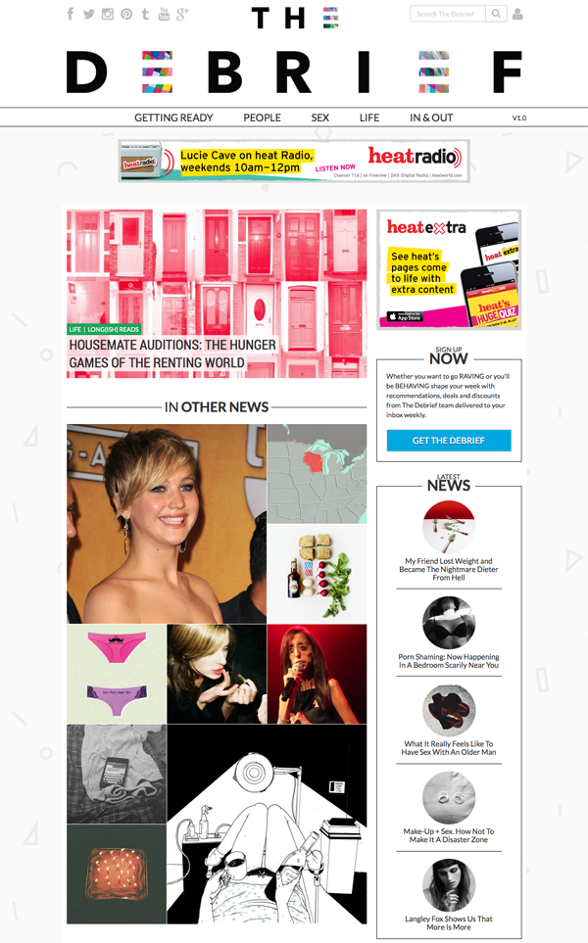
ONLINE INNOVATION
Bauer Media has launched a new multi-platform brand aimed at the women’s market.
The Debrief features a mix of tailored content around five editorial pillars; People, Life, Getting Ready, Sex and In/Out.
It is aimed at ABC1 20-something women and has been partnered by Bacardi and H&M at launch.
Bauer Media is backing the launch with an extensive digital marketing campaign with creative by Gravity Road.
Paul Keenan, Chief Executive of Bauer Media, said: “We’re hugely excited about the launch of The Debrief. We believe it is genuinely different and will engage and resonate with this influential audience.
“We are also delighted that brand partners of the calibre of Bacardi and H&M share our vision for connecting with this audience in a new and unique way
Feb 2014
www.ppa.co.uk/marketing

Slide 47
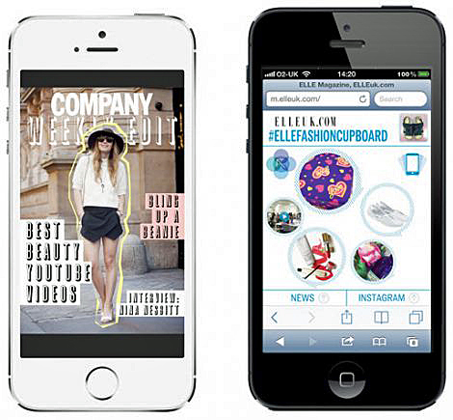
MOBILE INNOVATION
Hearst Magazines UK has launched new mobile products for its ELLE and Company brands.
The publisher said the launches were in response to the increase in mobile traffic across its portfolio of brands which has risen by 70% over the past six months.
ELLE UK’s mobile audience now makes up 30% of its total monthly users, with page views up 82% year-on-year, while 45% of Company’s monthly online users are now from tablet and mobile devices.
The ELLE Fashion Cupboard mobile pop up has been specifically built around the way its readers use their phones and is designed to be played with, reacting to shaking and allowing users to ‘pop’ bubbles to access more content.
The content changes every 45 minutes as the ELLE Fashion Cupboard updates.
Feb 2014
www.ppa.co.uk/marketing

Slide 48
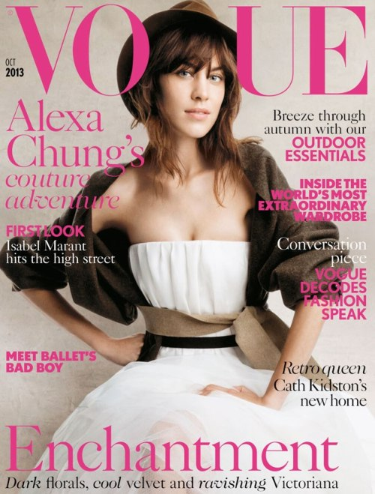
EVENT INNOVATION
British vogue unveils latest speakers for vogue festival 2014
Speakers will include Alexa Chung, Alexandra Shulman, Amanda Harlech, Angela Missoni, Daniel Marks, Franca Sozzani, Grayson Perry, Jack and Lazaro of Proenza Schouler, Karlie Kloss, Katie Hillier and Lily Allen.
Tickets will be available to the general public from February 20 and will provide guests with access to leading designers, photographers, celebrities, models and fashion editors.
The two-day event includes interviews, panels, trend talks and workshops.
It is being held on Saturday 29th and Sunday 30th March at the Queen Elizabeth Hall, Southbank Centre, London.
Feb 2014
www.ppa.co.uk/marketing

Slide 49
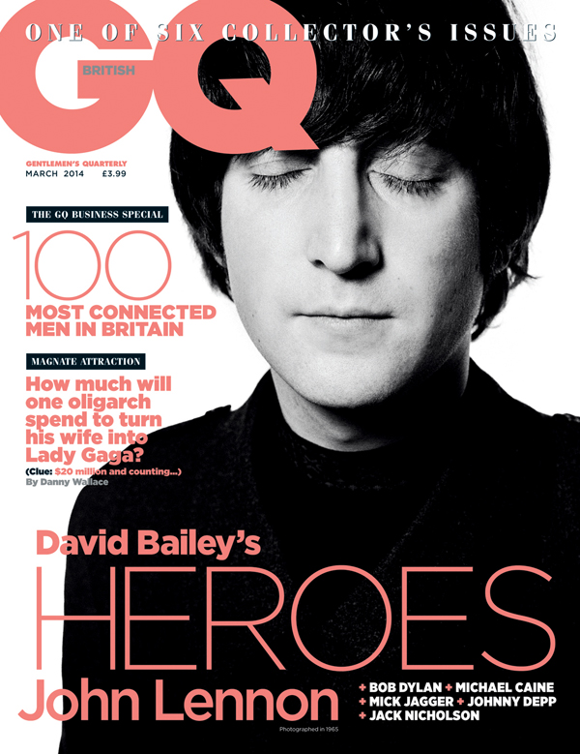
EDITORIAL INNOVATION
GQ has announced plans that will see it publish a choice of six covers for its March 2014 issue, featuring iconic portraits by legendary photographer David Bailey.
Cover stars include John Lennon, Bob Dylan, Mick Jagger, Michael Caine, Jack Nicholson and Johnny Depp.
The March issue includes tributes on each star from Yoko Ono, Jonathan Lethem, Martin Scorsese, John Naughton, Tom Cruise and Bruce Robinson, as well as behind-the-lens tales about each from Bailey himself.
The publication of the covers coincides with the launch of Bailey’s new exhibition called Bailey’s Stardust, which is being held at London’s National Portrait Gallery.
The March 2014 issue of GQ is on sale from February 6.
Jan 2014
www.ppa.co.uk/marketing

Slide 50
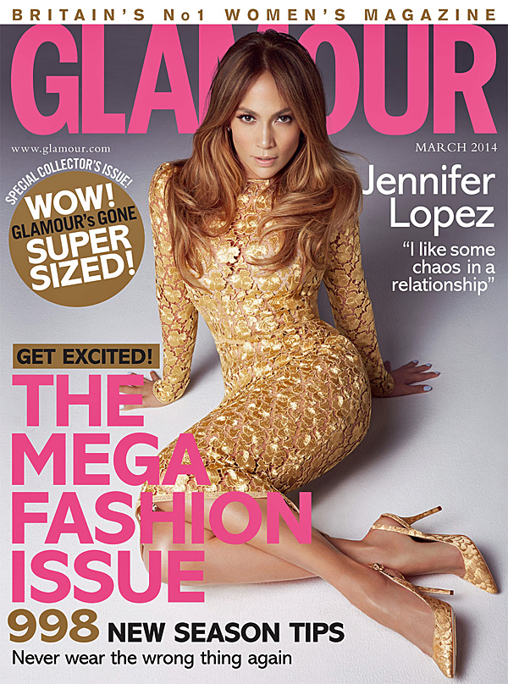
PRINT INNOVATION
The supersized edition of Glamour magazine has hit the newsstand.
A publishing first for Glamour, the March 2014 edition has been supersized to showcase the Spring Summer 2014 collections.
Forty per cent of the editorial pages within the issue are dedicated to fashion and fashion advertising pages are up 30 per cent year-on-year, including advertising from Dolce and Gabbana, Emporio Armani, Marc by Marc Jacobs, Sport Max, and DKNY.
Simon Kippin, Glamour Publishing Director, said: “I’m delighted that our clients have embraced the special limited-edition large-format March issue, and excited to be able to showcase the new collections and campaigns in this way, whilst offering readers an additional print option of their favourite magazine.”
The March 2014 issue will be followed by subsequent selected issues, available in a choice of formats.
The size of the alternative issue is 285mm x 215mm, similar to British Vogue, and is priced at £2.
Jan 2014
www.ppa.co.uk/marketing

Slide 51
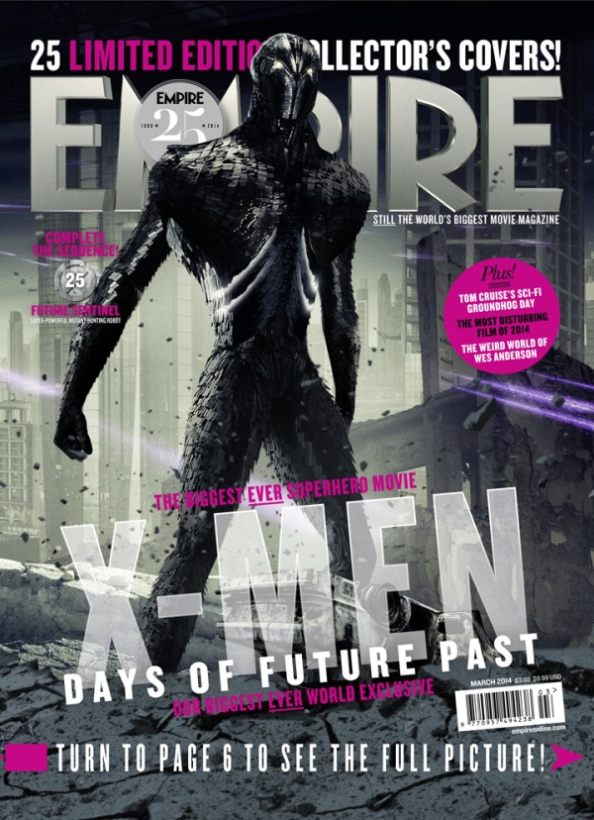
SOCIAL INNOVATION
Empire is starting a year of celebrations by publishing a series of 25 X-Men covers to commemorate its 25th anniversary.
The March issue will feature the covers ahead of the release of ‘X-Men: Days of Future Past’ later this year.
The exclusive covers will feature cast, both past and present, and once assembled the covers fit together to create one panoramic image.
In a first for the film brand, the film’s Director Bryan Singer will feature on his very own cover.
Each exclusive cover has been revealed via a 24-hour social media campaign which featured cast members including James McAvoy, Michael Fassbender, Hugh Jackman and Jennifer Lawrence.
Mark Dinning, Editor-In-Chief at Empire, said: “Over the next 12 months we will deliver a succession of the biggest exclusives in this brand's already illustrious history, working with the biggest names in Hollywood to bring film fans the world over
some genuine movie events.”
Jan 2014
www.ppa.co.uk/marketing

Slide 52
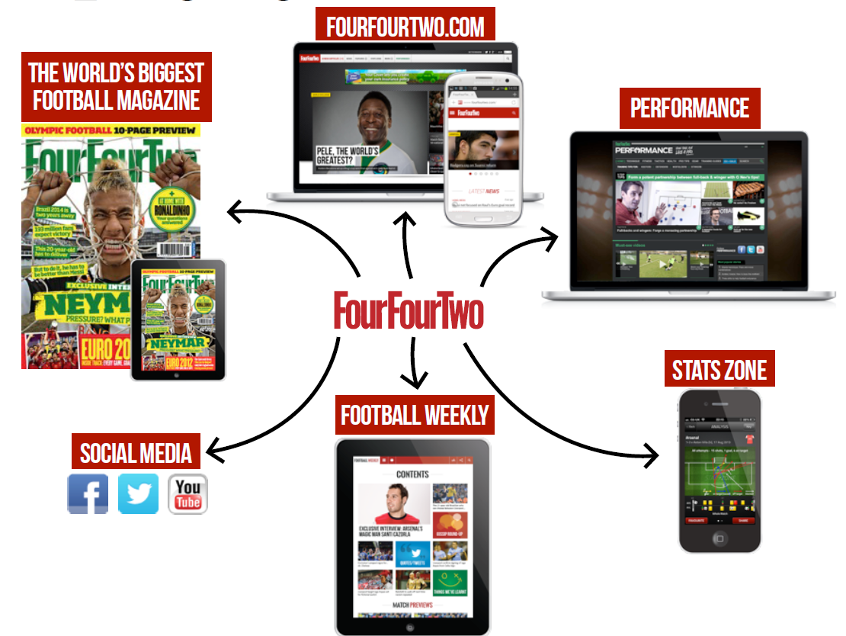
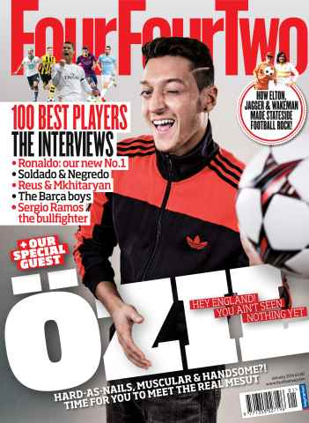
A MAGAZINE IN 2014

Slide 53
INSPIRING FANS WITH THE MOST AUTHENTIC
CONTENT IN THE WORLD … ANYWHERE

Slide 54
IN YOUR CASE (STUDIES) …

